Slide 1
Geoservicios para Smart cities
-
Introducción Smart Cities y Open Data
Victor Pascual Ayats
Wladimir Szczerban
MTIG 2019-2020
Victor.pascual@icgc.cat
Wladimir.szczerban@icgc.cat

Slide 2
Introducción Smart cities
A smart city is an urban area that uses different types of electronic data collection sensors to supply information used to manage assets and resources efficiently. This includes data collected from citizens, devices, and assets that is processed and analyzed to monitor and manage traffic and transportation systems, power plants, water supply networks, waste management, law enforcement, information systems, schools, libraries, hospitals, and other community services
Fuente: https://en.wikipedia.org/wiki/Smart_city

Slide 3
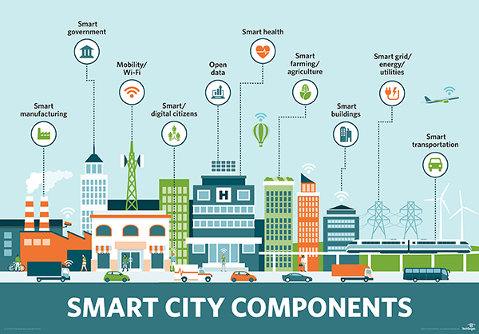
Introducción Smart cities
Smart cities es tecnología de la información

Slide 4
Introducción Smart cities
Smart city: ejemplo Barcelona
Barcelona has established a number of projects that can be considered 'smart city' applications within its "CityOS" strategy. For example, sensor technology has been implemented in the irrigation system in Parc del Centre de Poblenou, where real time data is transmitted to gardening crews about the level of water required for the plants. Barcelona has also designed a new bus network based on data analysis of the most common traffic flows in Barcelona, utilising primarily vertical, horizontal and diagonal routes with a number of interchanges. Integration of multiple smart city technologies can be seen through the implementation of smart traffic lights as buses run on routes designed to optimise the number of green lights. In addition, where an emergency is reported in Barcelona, the approximate route of the emergency vehicle is entered into the traffic light system, setting all the lights to green as the vehicle approaches through a mix of GPS and traffic management software, allowing emergency services to reach the incident without delay. Much of this data is managed by the Sentilo Platform (http://www.sentilo.io/wordpress/)
Fuente: https://en.wikipedia.org/wiki/Smart_city#Barcelona

Slide 5
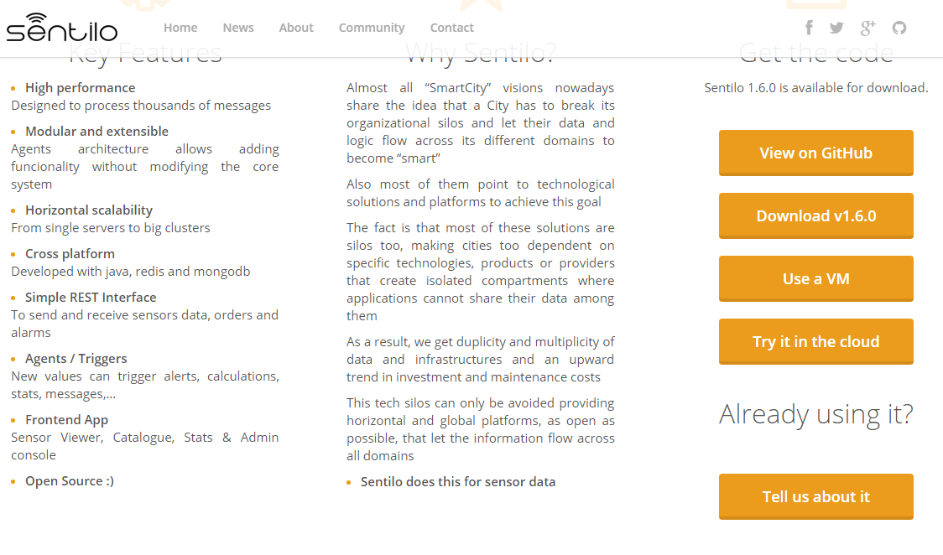
Introducción Smart cities
Smart cities ejemplo Barcelona
http://www.sentilo.io/wordpress/

Slide 6
Introducción Smart cities
Smart cities también es comportamiento humano

Slide 7
Introducción Smart cities
Tecnológicamente una Smart City se basa en un conjunto servicios (web) especializados
Si estos servicios contienen una componente geográfica (coordenadas),
hablaremos de :
GeoServicios

Slide 8
Conceptos Geoservicios
¿Qué es un GeoServicio y para qué sirve?

Slide 9
Conceptos Geoservicios
Es una interfaz que recibe parámetros* + valores y devuelve una respuesta* formateada
* La parámetros y formatos son conocidos y están documentados en formatos API

Slide 10
Conceptos Geoservicios
API- Application Programming Interface
In computer programming, an application programming interface (API) is a set of subroutine definitions, protocols, and tools for building application software. ( ….)
An API may be for a web-based system, operating system, database system, computer hardware, or software library. An API specification can take many forms, but often includes specifications for routines, data structures, object classes, variables, or remote calls.
Documentation for the API is usually provided to facilitate usage
Fuente: https://en.wikipedia.org/wiki/Application_programming_interface

Slide 11
Conceptos Geoservicios
API- Application Programming Interface
In computer programming, an application programming interface (API) is a set of subroutine definitions, protocols, and tools for building application software. ( ….)
An API may be for a web-based system, operating system, database system, computer hardware, or software library. An API specification can take many forms, but often includes specifications for routines, data structures, object classes, variables, or remote calls.
Documentation for the API is usually provided to facilitate usage
Direcciones web HTTP
HTTP GET / POST
Entorno WEB o APP Híbridas
Browser
HTML
JavaScript
CSS
API Doc Reference
Documentación de
Request
Response

Slide 12
Conceptos Geoservicios
El protocolo HTTP tiene diferentes metodos de interrogación / inserción
GET
POST
UPDATE
DELETE
INSERT
HTTP – GET es el más utilizado en APIs web

Slide 13
Conceptos Geoservicios
Tipos de Peticiones HTTP- GET
KvP : (Key value Pair) Después ? Pasamos parámetro = valor y concatenamos con &
http://midominio.com/servidor/enpoint?parametro1=valor1&parametro2=valor=2
RESTful : La URL define el recurso, dentro de una arquitectura REST
http://midominio.com/servidor/recurso.json
RESTful and KvP : La URL define el recurso, pero podemos filtrar recurso con parámetros
http://midominio.com/servidor/recurso.json?parametro1=valor1
Utilizada en APIs Opendata

Slide 14
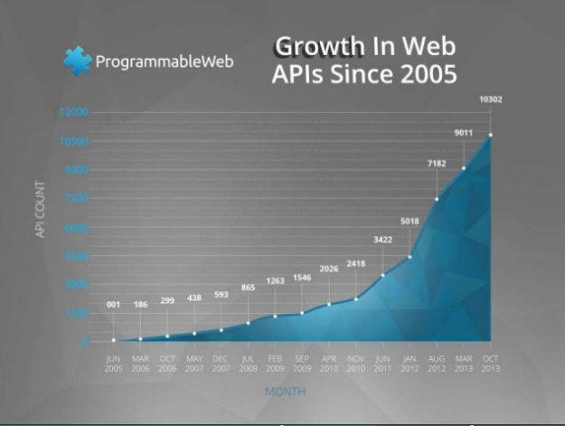
Conceptos Geoservicios
Visitamos
https://www.programmableweb.com

Slide 15
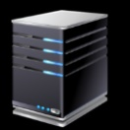
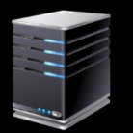
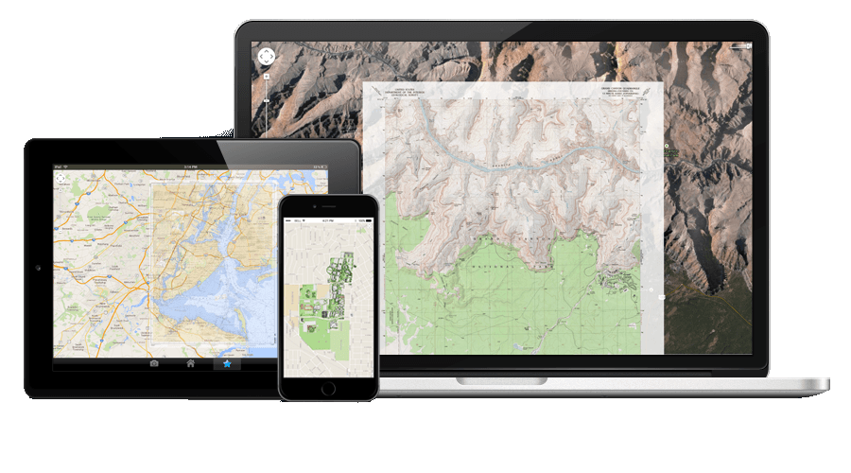
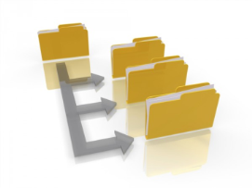
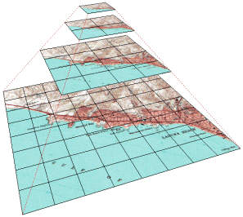
Geoservicios arquitectura
Entorno cliente
Entorno Servidor
http://
Python
Java
JavaScript(Node)
SQL
PHP
ASPX
……
JavaScript
CSS
HTML

Slide 16
Conceptos OpenData
Muchos servicios y/o información relativa a Smart City, son expuestos cómo OpenData (Datos Abiertos) en portales de administraciones públicas.
Son las llamada “Plataformas “ para la publicación y gestión de OpenData

Slide 17
Conceptos OpenData
Contexto

Slide 18
Conceptos OpenData
Las nuevas Plataformas de publicación OpenData equilibran la barra entre los esfuerzos entre representar/exponer y consumir/reutilizar.

Slide 19
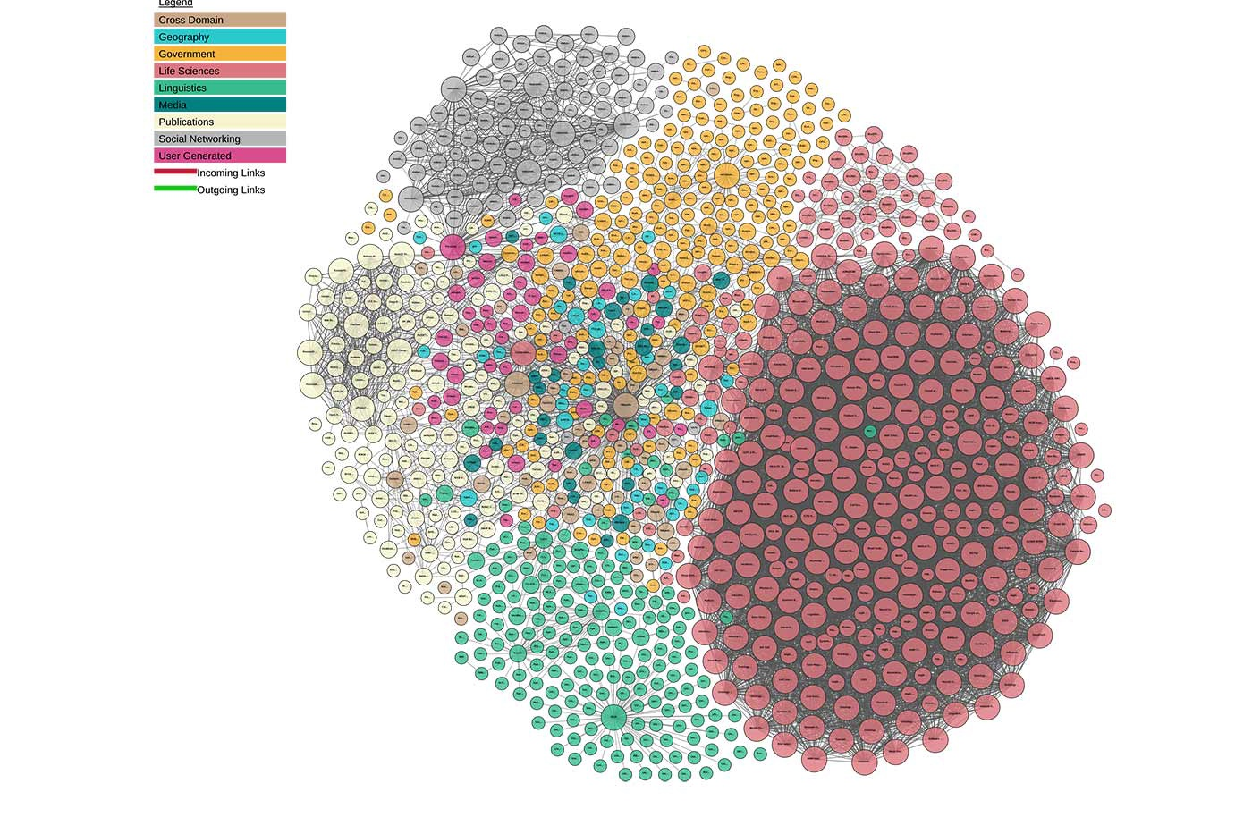
Linked Data
http://lod-cloud.net/

Slide 20
Conceptos OpenData
Arquitectura Plataformas de publicación
Estructura Front-End (web)
Generación de portales
Herramientas gestión interna de datos
Herramientas visualizaciones de datos.
Plugins, ejemplo para Geodatos
Back-End
Modelo i estructura BBDD
API
Un portal de un cliente puede:
Residir en la nube
En servidores proveedor
En servidores cliente
Portal global
Agregador de portales

Slide 21
Plataformas Open Data
¿Puedo desarrollar nuevos Plugins para las Plataformas?
¿Podría crear una API de APIs?

Slide 22
Plataformas Open Data
VAMOS INTRODUCIRNOS EN 3 PLATAFORMAS ...
Socrata
OpenDatasoft
Ckan

Slide 23
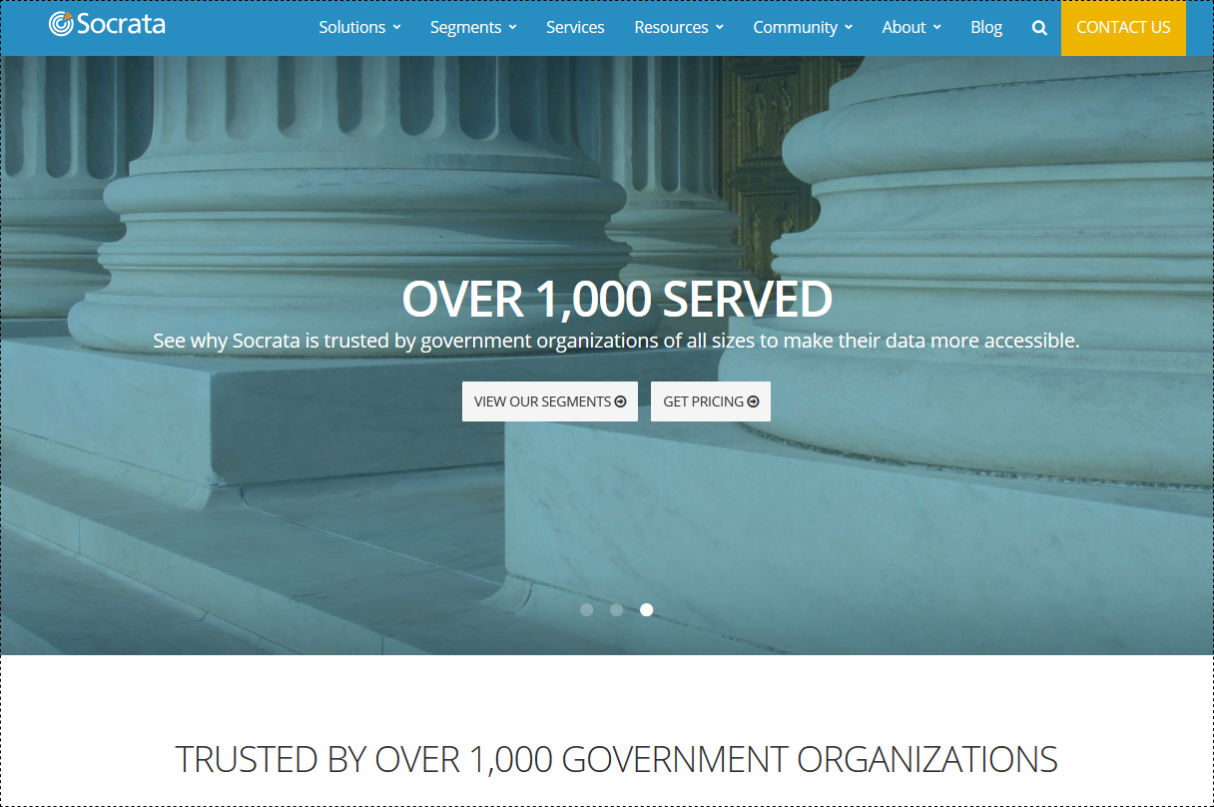
Socrata
Sede: Seattle, Washington, USA
Fundada: 2007
Modelo negocio:
Software-as-a-Service bajo
licencia.
API y SDK’s (acceso a datos)
OpenSource.
Socrata is a company that provides cloud-based data visualization and analysis tools for opening government data. Originally called Blist, Socrata was founded in February 2007. Socrata targets non-technical Internet users who want to view and share government, healthcare, energy, education, or environment data. Its products are issued under a proprietary, closed, exclusive license
Fuente: https://en.wikipedia.org/wiki/Socrata

Slide 24
Links
https://socrata.com/
https://socrata.com/solutions/publica-open-data-cloud/
https://github.com/socrata

Slide 25
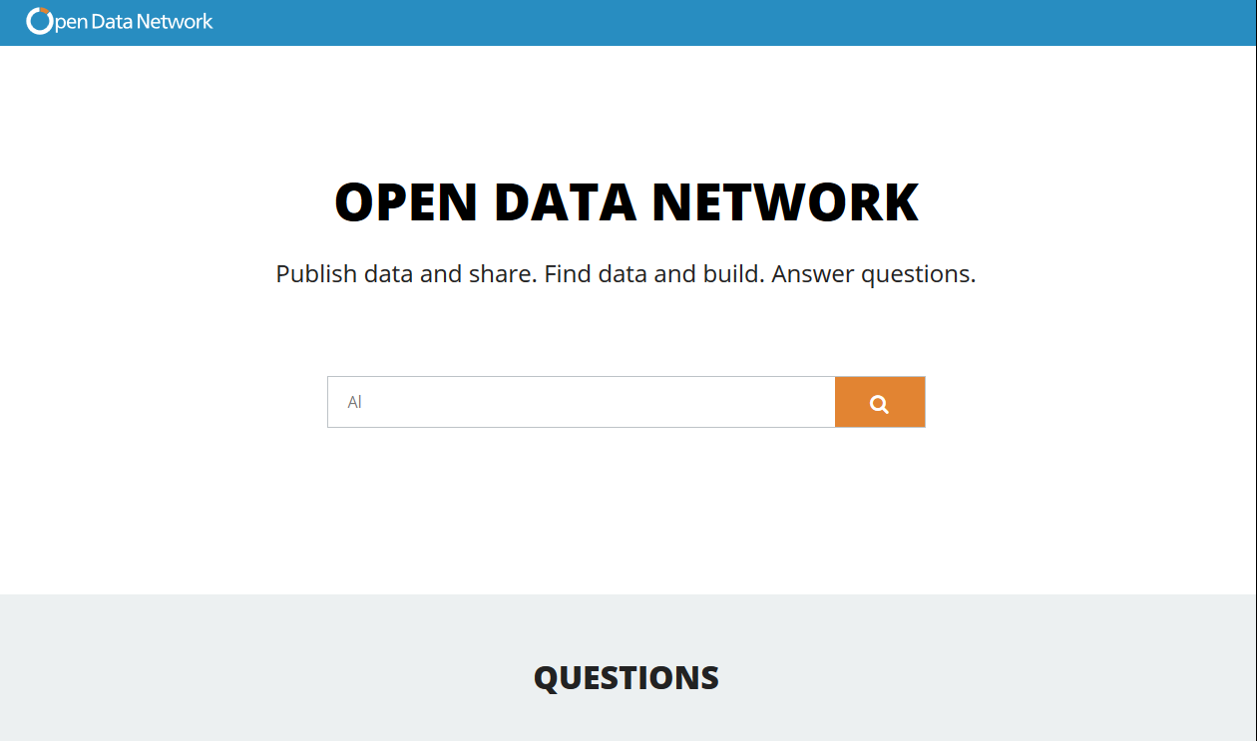
SOCRATA : Portal global
https://www.opendatanetwork.com/
https://socrata.com/blog/socrata-introduces-open-data-network/

Slide 26
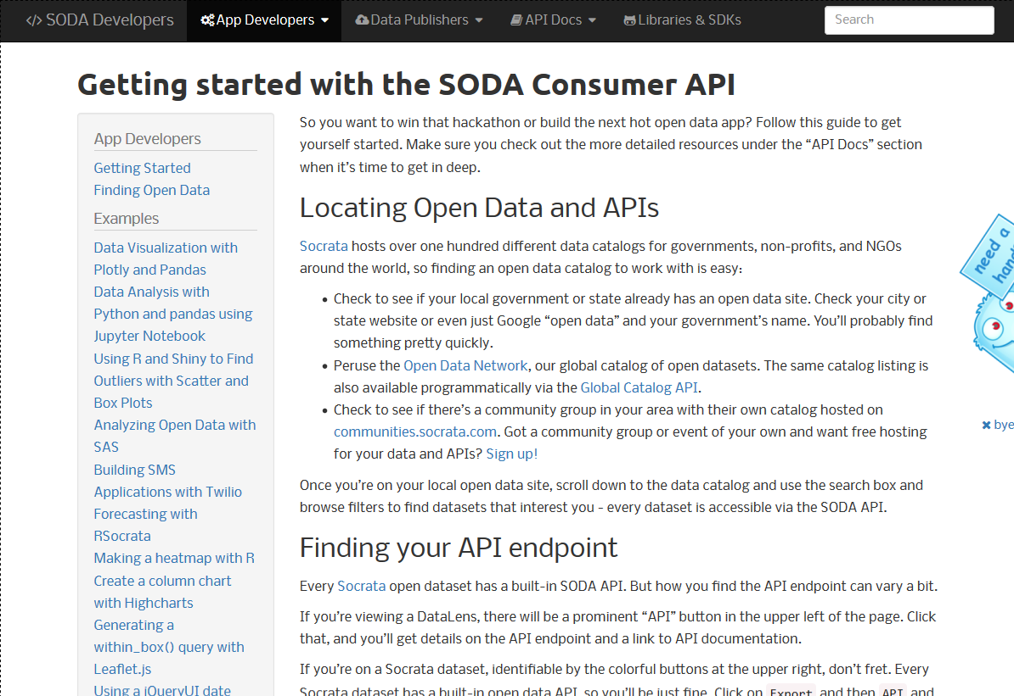
SOCRATA APIs:
DISCOVERY API
API (SODA)
http://docs.socratadiscovery.apiary.io/
https://dev.socrata.com/consumers/getting-started.html

Slide 27
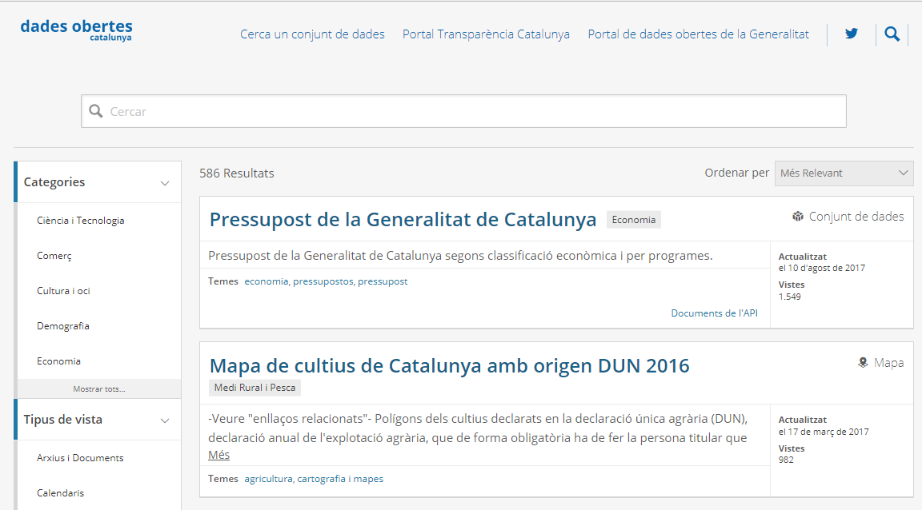
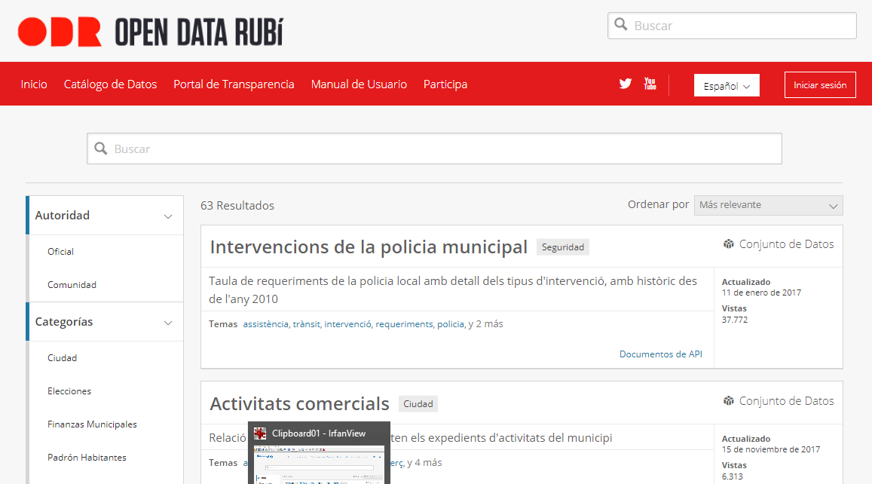
Portales con Socrata:
https://analisi.transparenciaatalunya.cat/
https://opendata.rubi.cat/es/browse

Slide 28
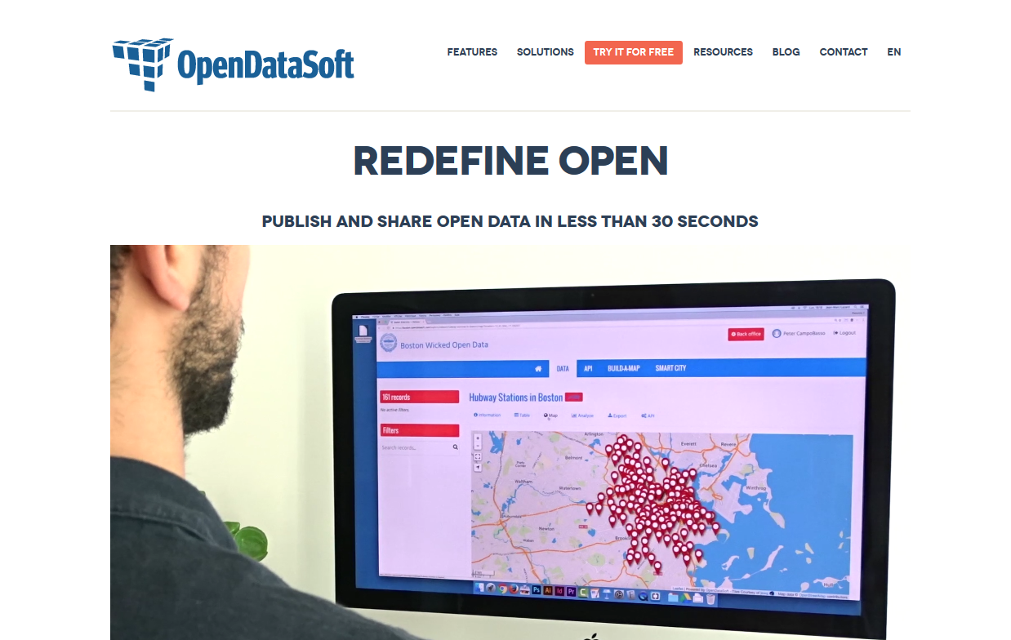
OPENDATASOFT
Sede: Paris, Fr
Fundada: 2011
Modelo negocio:
Software-as-a-Service bajo
licencia.
API y SDK’s (acceso a datos)
OpenSource
Gratuito para “nonprofit” y ONG
OpenDataSoft is a private software company specialized in transforming structured data into API and visualizations. Founded in 2011, OpenDataSoft targets non-technical users who wish to share and visualize government, health, energy and environmental data.
OpenDataSoft allows restricted and open sharing ecosystems like open data portals.
Fuente: https://en.wikipedia.org/wiki/opendatasoft

Slide 29
Links
https://www.opendatasoft.com/
https://www.opendatasoft.com/open-data-solutions/
https://github.com/opendatasoft

Slide 30
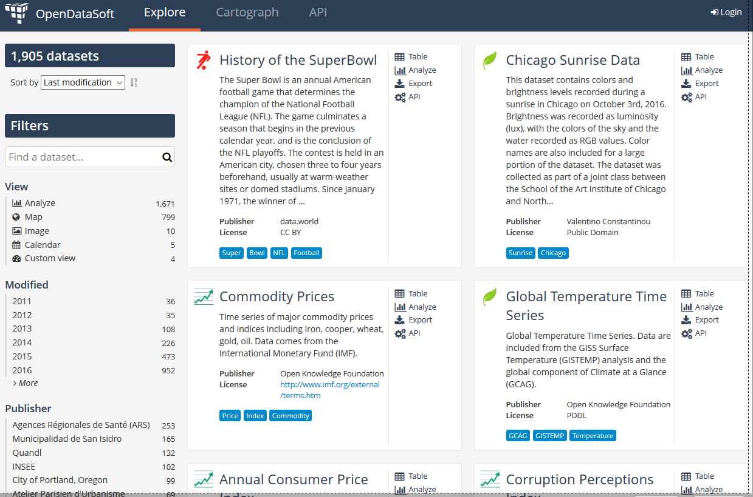
OPENDATASOFT :Portal Global glo
https://public.opendatasoft.com/explore/?sort=modified/

Slide 31
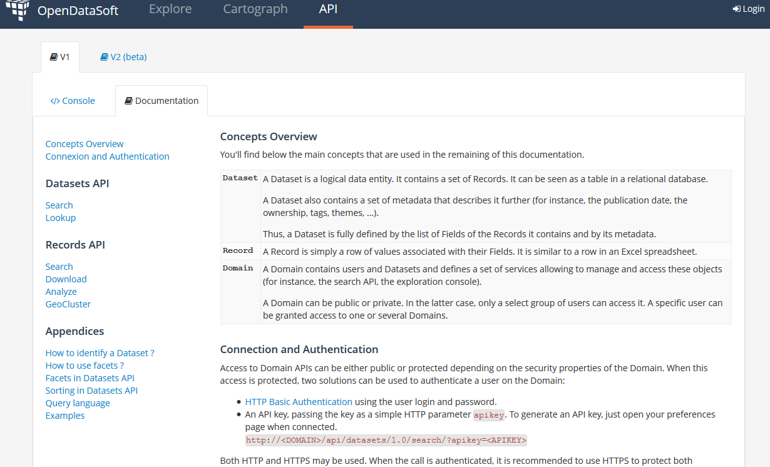
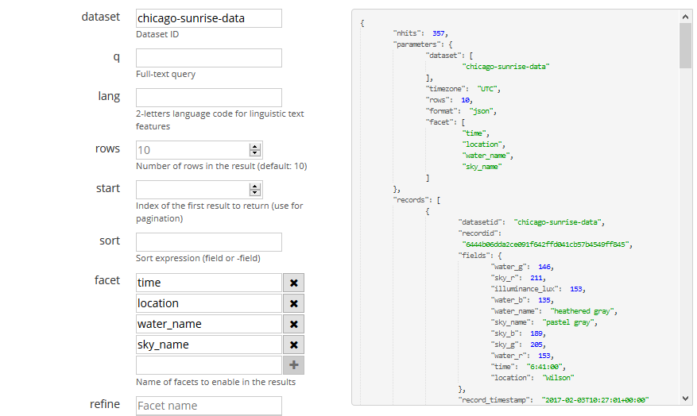
OPENDATASOFT : API
https://public.opendatasoft.com/api/v1/console/datasets/1.0/search/

Slide 32
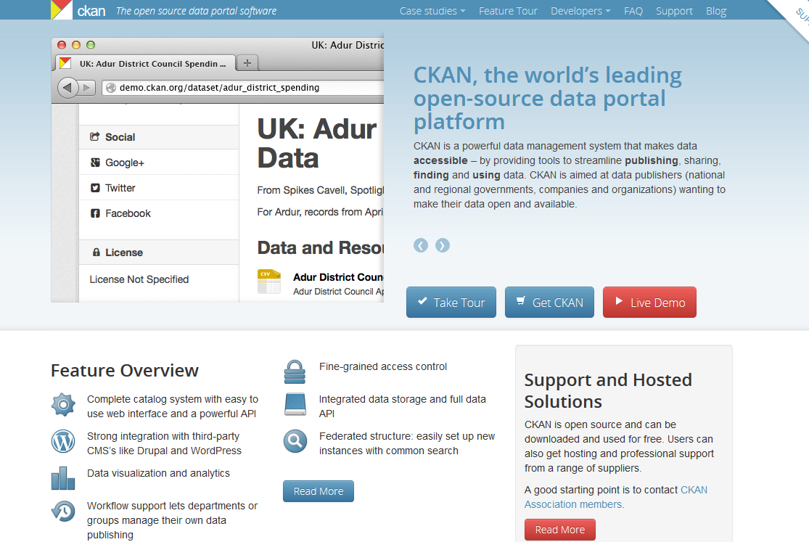
CKAN
Sede: Cambrigde, UK
Fundación : 2004
Modelo negocio:
Fundación Open Knowledge International
Todo OpenSource pero también ofrecen servicio (de pago) de Hosting.
Open Knowledge International (OKI) (known as the Open Knowledge Foundation (OKF) until April 2014,[2] then Open Knowledge until May 2016[3]) is a global non-profit network that promotes and shares information at no charge, including both content and data.[4] It was founded by Rufus Pollock on 24 May 2004[5] in Cambridge, UK.
Fuente: https://en.wikipedia.org/wiki/Open_Knowledge_International

Slide 33
Links
https://ckan.org
https://github.com/ckan/ckan
https://datahub.io

Slide 34
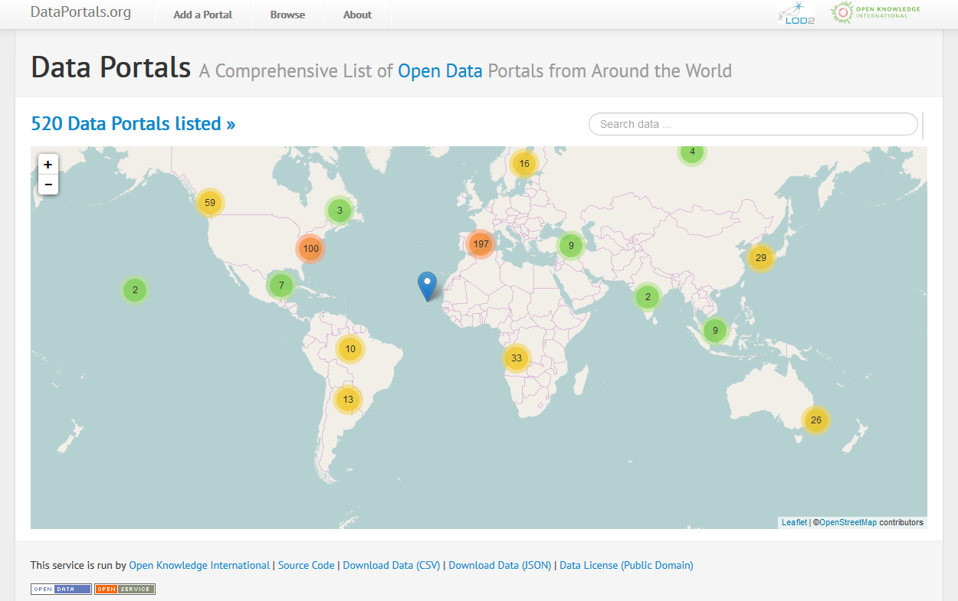
CKAN : Portal global
http://dataportals.org/
https://datahub.io/

Slide 35
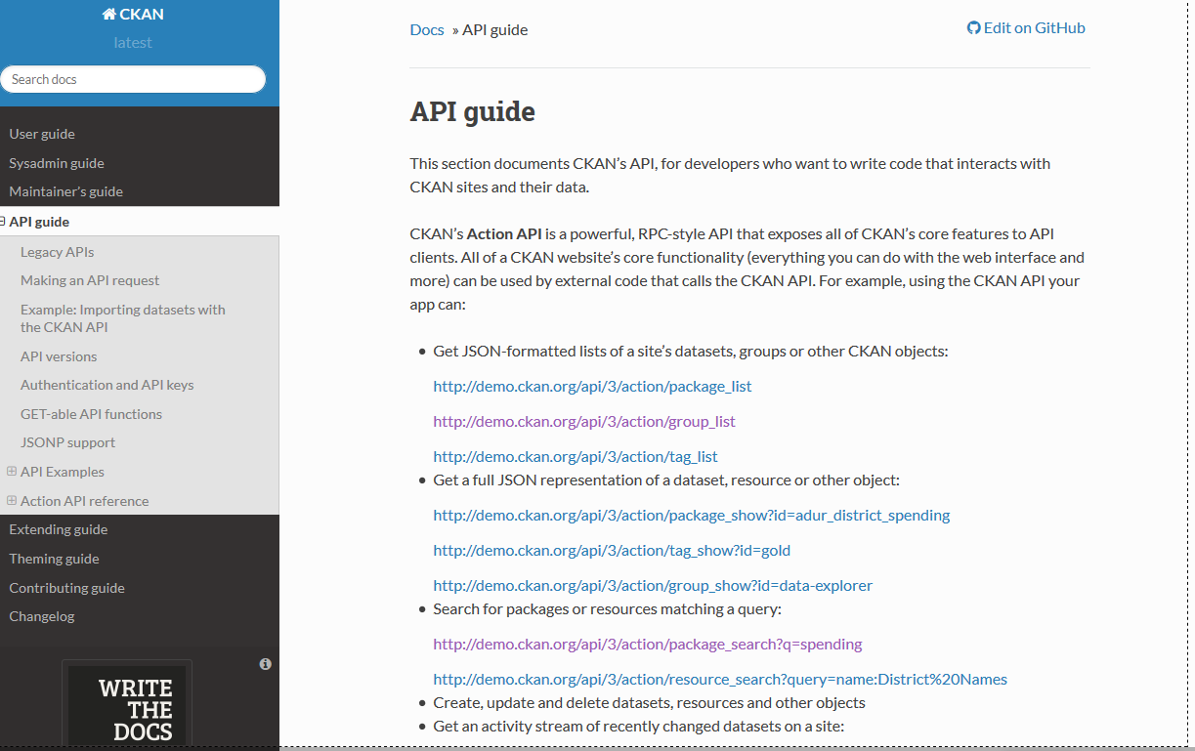
CKAN : API
http://docs.ckan.org/en/latest/api/index.html

Slide 36
CKAN : API NIVELES
GLOBAL “API”:
http://dataportals.org/api/data.json/
Domain “API”:
http://demo.ckan.org/api/3/action/package_search?q=museu
http://opendata-ajuntament.barcelona.cat/data/api/3/action/package_search?q=museu
http://demo.ckan.org/api/3/action/resource_search?query=description:Museu
http://opendata-ajuntament.barcelona.cat/data/api/3/action/resource_search?query=description:barri
Dataset “API”: (FileStore y DataStore):
Create | http://demo.ckan.org/api/action/datastore_create
Update / Insert | http://demo.ckan.org/api/action/datastore_upsert
Query | http://demo.ckan.org/api/action/datastore_search
Query (via SQL) | http://demo.ckan.org/api/action/datastore_search_sql

Slide 37
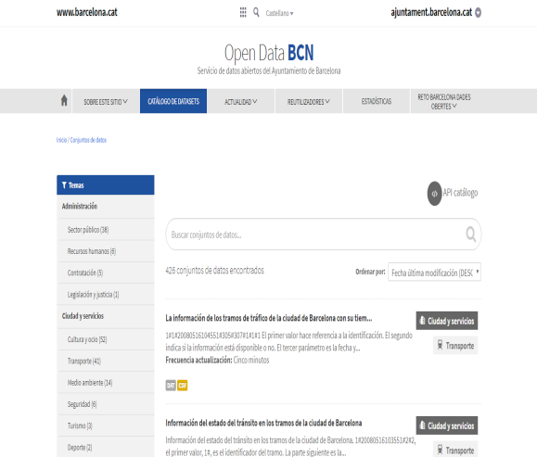
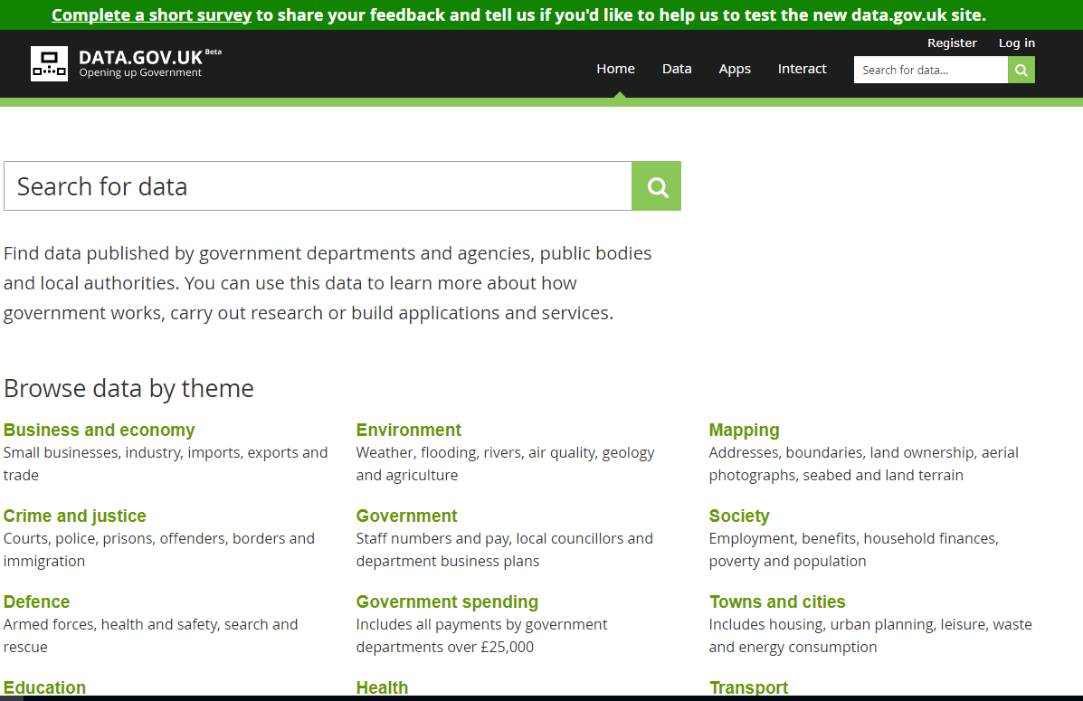
Portales CKAN
http://opendata-ajuntament.barcelona.cat/data/es/dataset
https://data.gov.uk/

Slide 38
Conclusiones
CKAN es OpenSource
Puedo instalarlo en mi servidor o utilizar servicio web
Puedo automatizar la gestión de datasets
Todos los Datasets están expuestos via API

Slide 39
Ejemplos de utilización API Socrata y CKAN
/utilización-servicio-opendata

